Slide 1
InstaMart Demo
Cape Stone Project
-By Bhoomika Suresh Bhagwat

Slide 2
For Users:

Slide 3
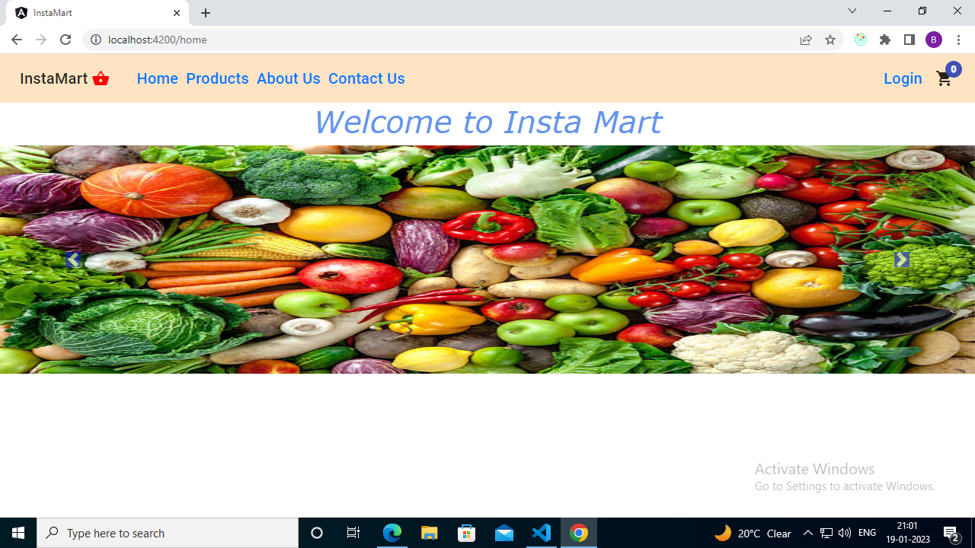
User first see this homePage which has corosoeul

Slide 4
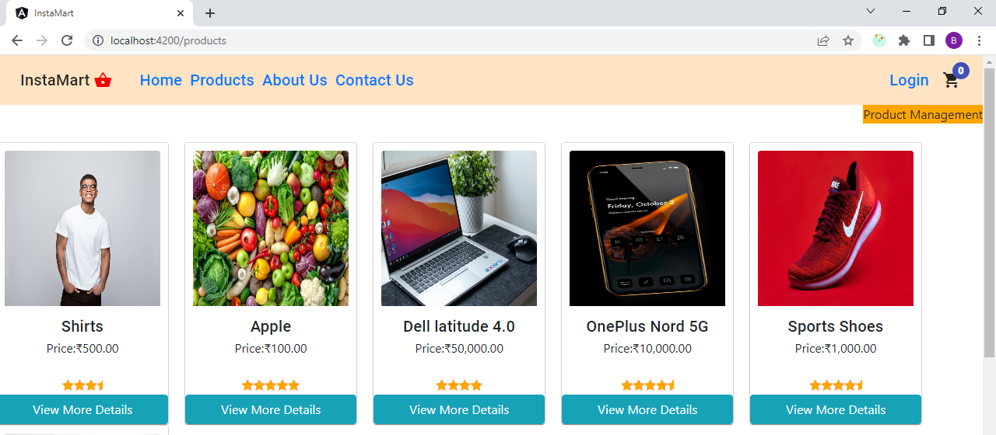
When user clicks on Products on navbar,this is the result

Slide 5
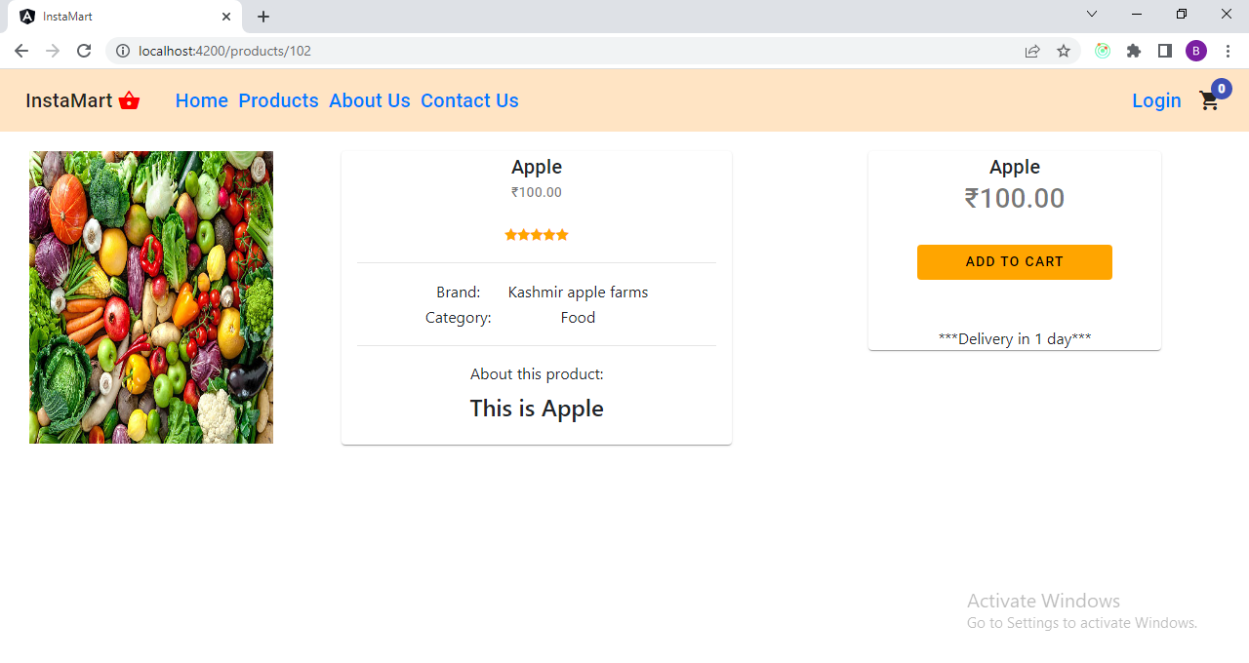
If User clicks on view more details,this page is rendered

Slide 6
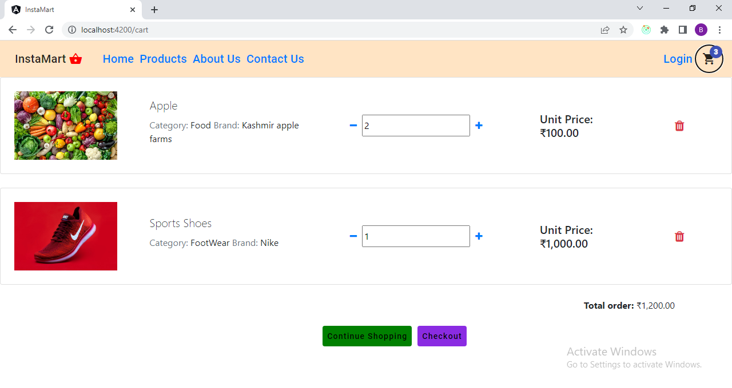
When user add products to cart,by clicking on cart icon on navbar cart can be viewed.

Slide 7
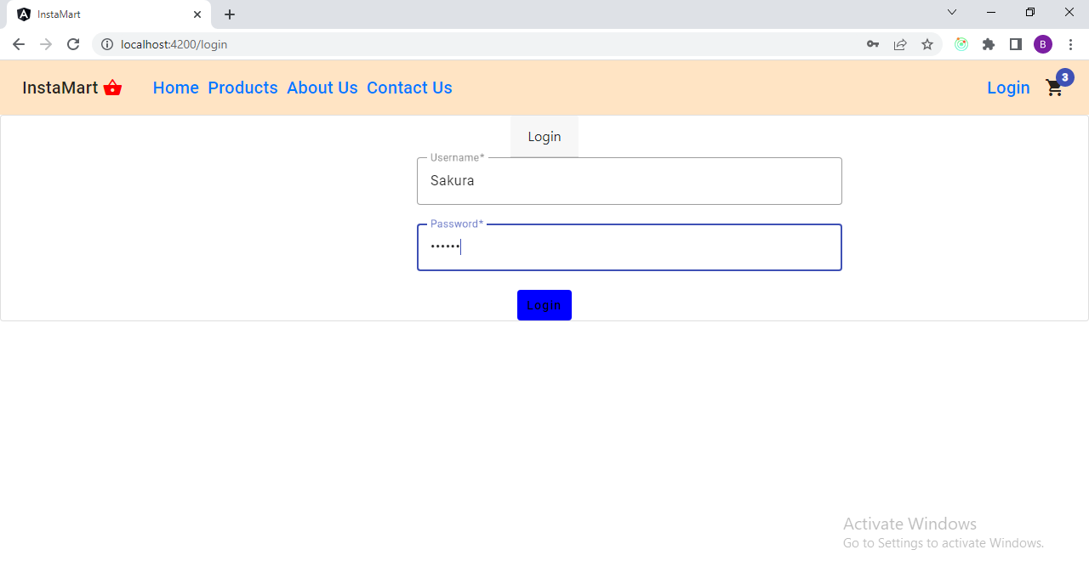
For Check out,user needs to login first with valid credentials.

Slide 8
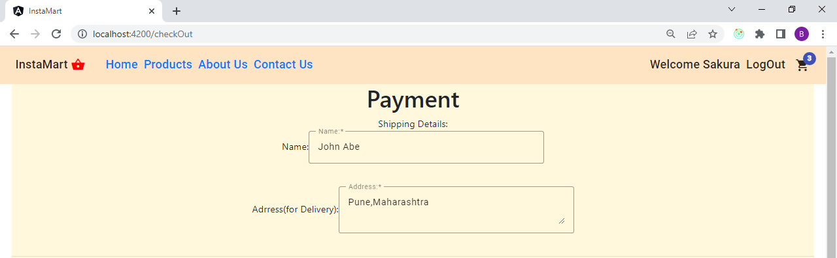
CheckOut Page (part 1)

Slide 9
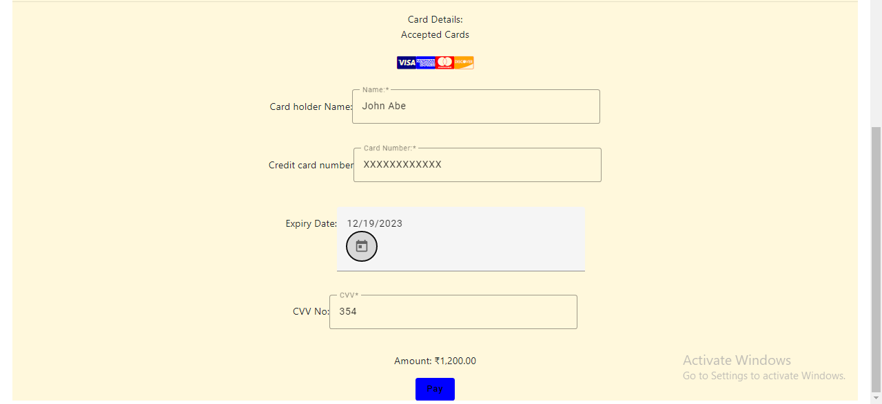
Check out page(part 2)

Slide 10
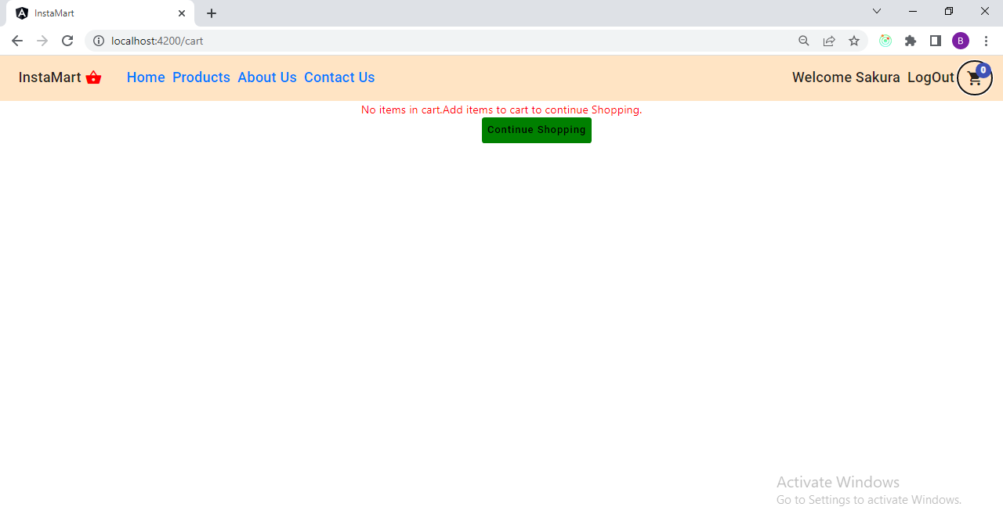
After successful payment is done,cart will be emptied.

Slide 11
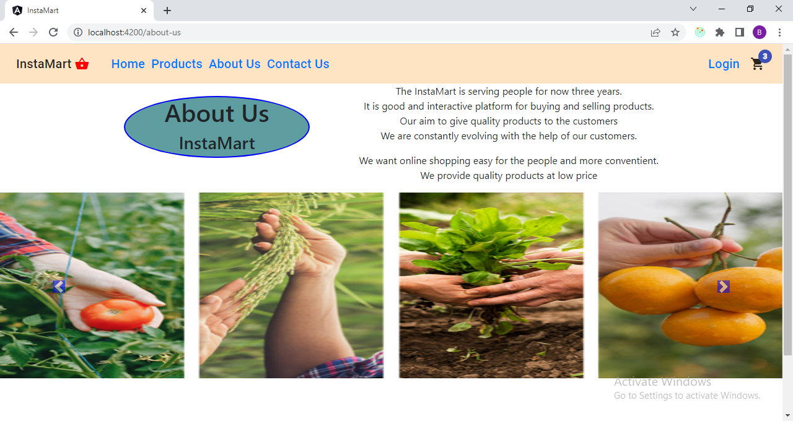
About us Page

Slide 12
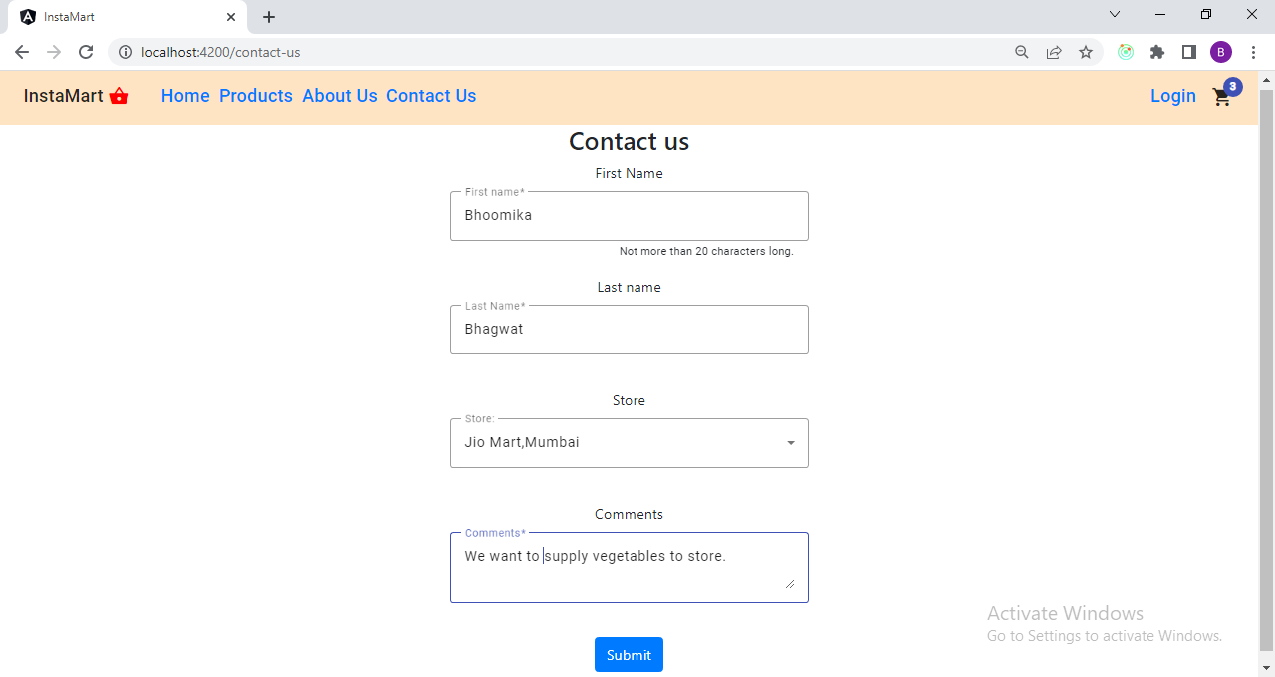
Contact Us form

Slide 13
For Admins:

Slide 14
On Products page,Product Management section is provided for product crud which only be perform by admins.

Slide 15
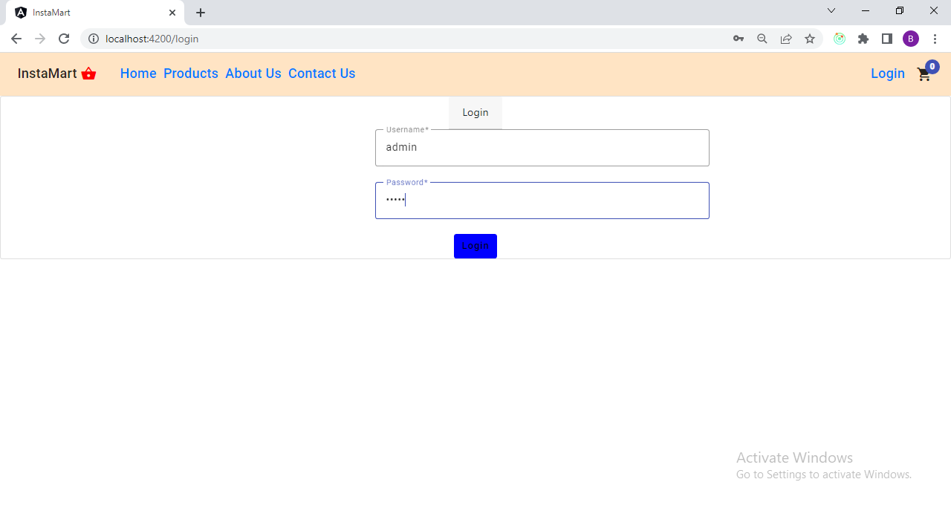
For Product Management, Login is required. Only admin credentials are valid to access the page.

Slide 16
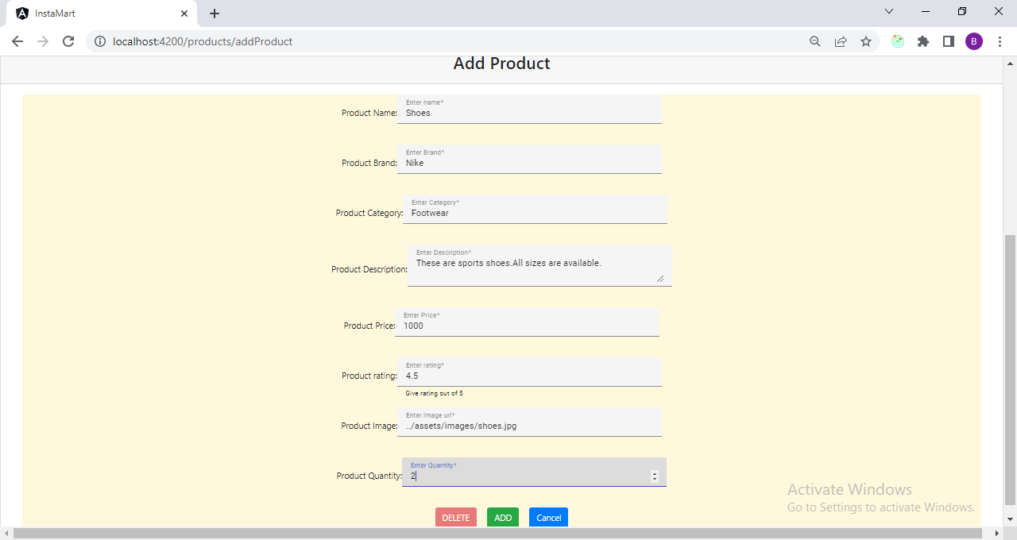
Form for Adding product

Slide 17
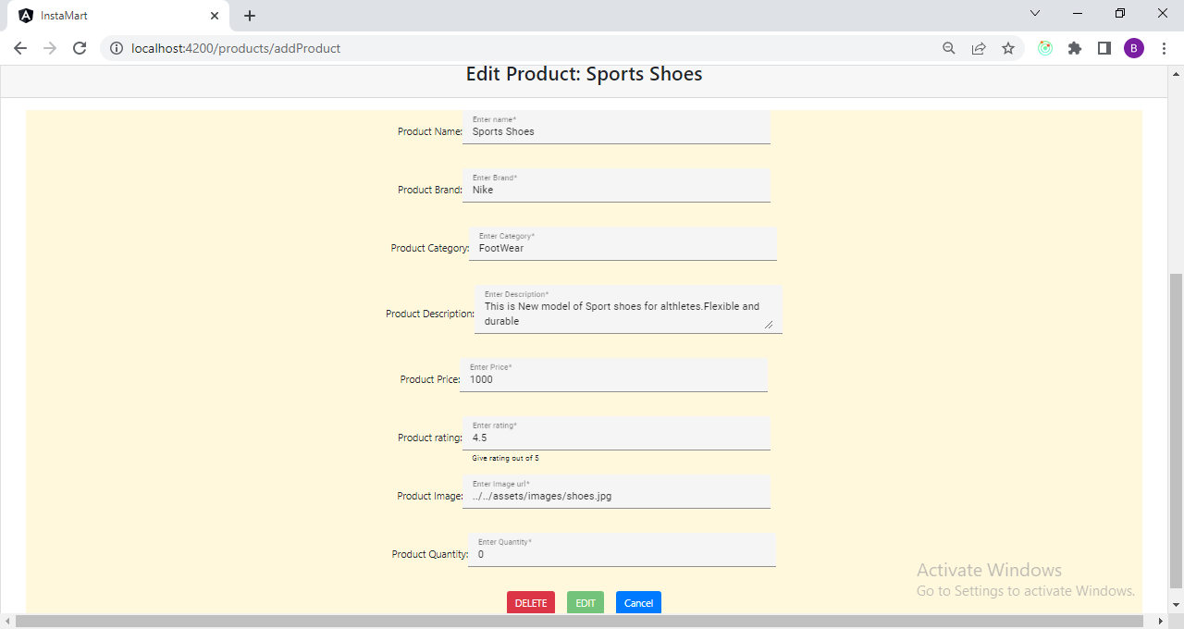
Update and Delete product(delete button will delete product- and edit button will update product)

Slide 18
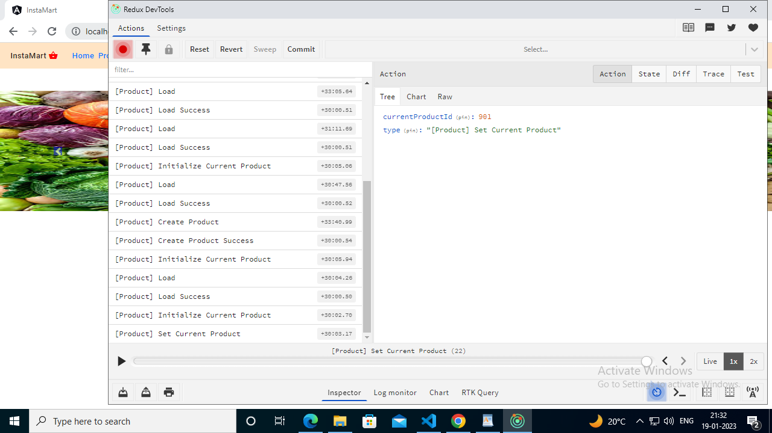
State Management of products(ngrx) for create product

Slide 19
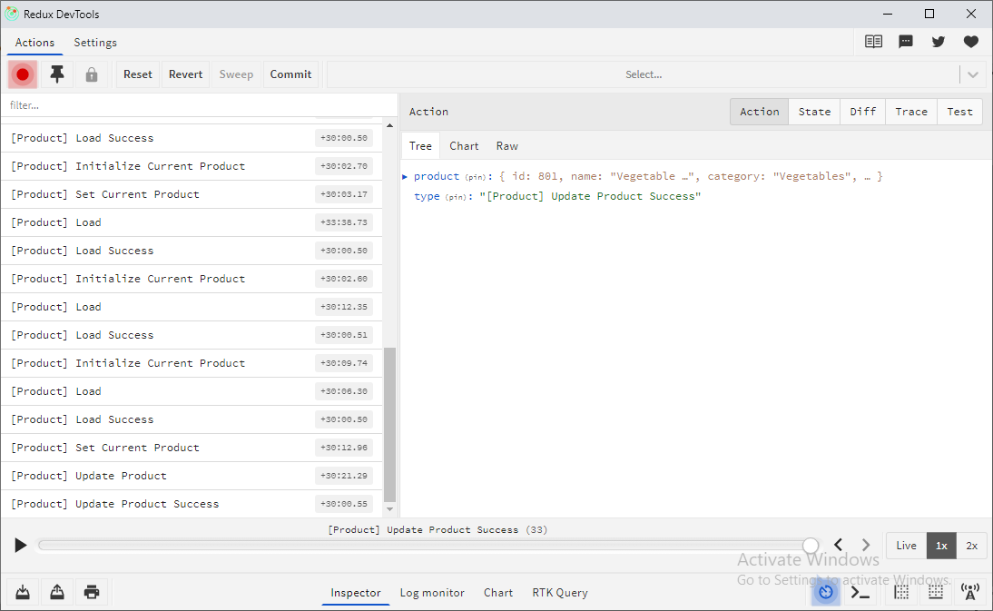
State Management of products(ngrx) for Update product

Slide 20
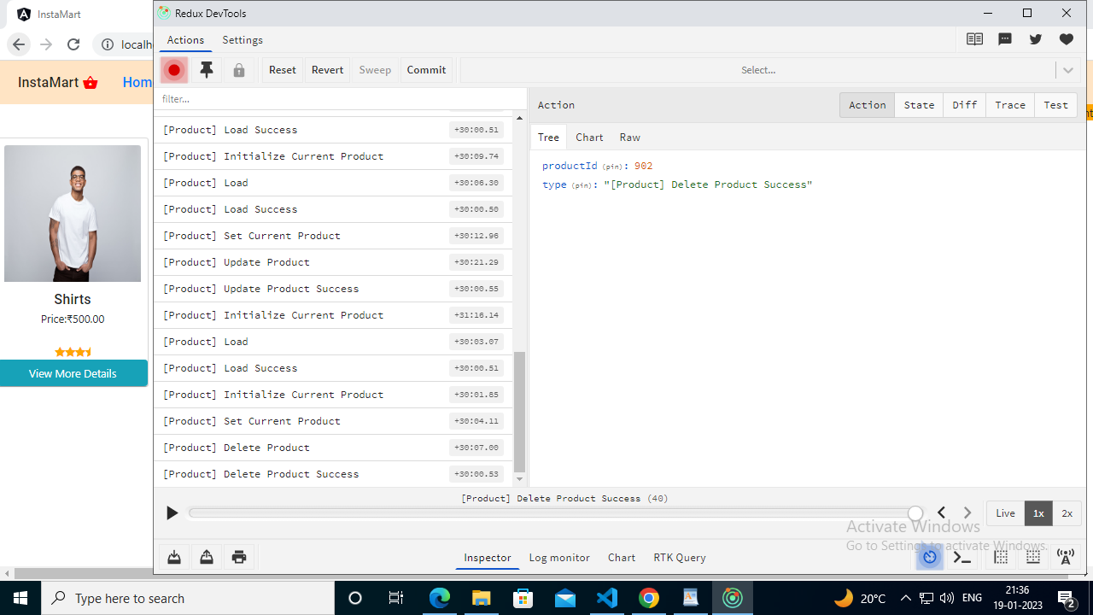
State Management of products(ngrx) for delete product

